Slide 1

CDSS Based Mobile Application for Stroke Assistance
In-House Project
Final Year Project Review
Project Mentor : Dr. Mrs. Gresha Bhatia
Group Number : 7
Group Members :
Manasi Shah
Kaushik Sahasranaman
Chaitanya Sondur
Riya Nadagire

Slide 2
Content
Introduction to Project
Lacuna in the Existing System
Literature Survey
Problem Definition
Methodology & Block diagram
Conceptual diagram and patient workflow diagram
Detailed Diagram
Workflow of the app
Implementation
Hardware and Software tools
Next Work Plan
Conclusion
References

Slide 3
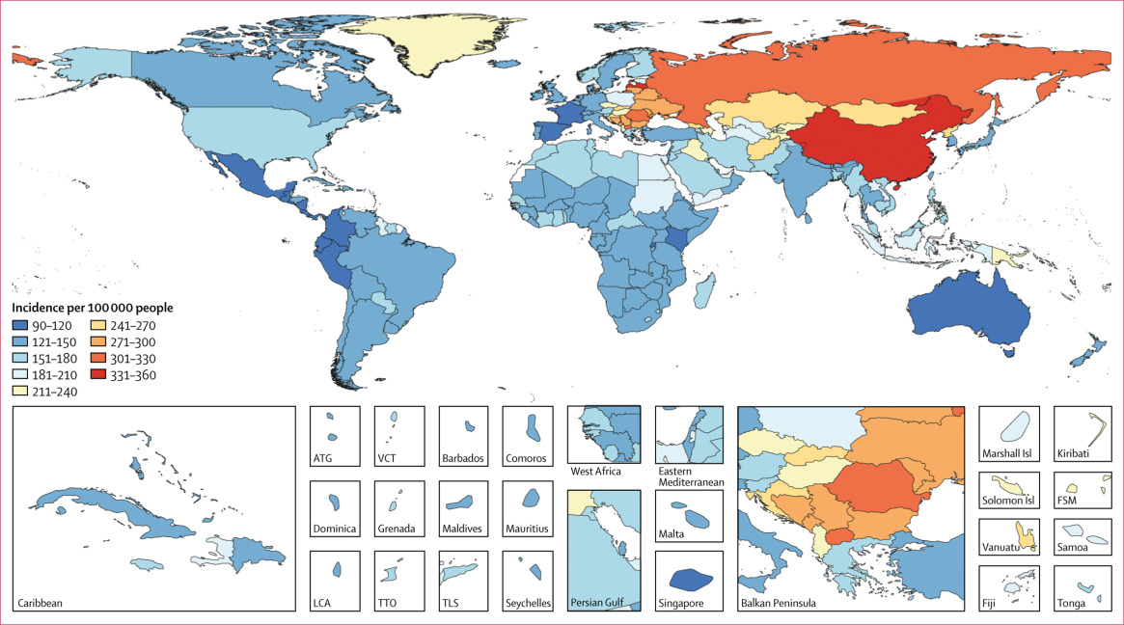
Introduction to Project
Globally, 1 in 4 adults over 25 will experience a stroke. 12.2 million new stroke cases and 6.5 million deaths are projected this year.
https://www.thelancet.com/journals/laneur/article/PIIS1474-4422%2819%2930034-1/fulltext

Slide 4
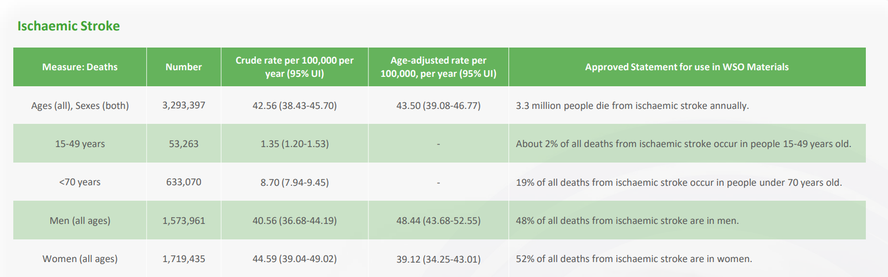
Introduction to Project
World Stroke Organization 2022 Statistics

Slide 5
Introduction to Project
Brain stroke, medically known as a cerebrovascular accident (CVA), is a debilitating and potentially life-threatening condition that arise from diminished or stopped blood supply to the brain, which damages or kills brain cells. Because of its high frequency, high death rate, and long-term disability among survivors, it is a major worldwide health concern.
Stroke carries a high risk of death. Survivors can experience loss of vision and/or speech, paralysis and confusion. Stroke is so called because of the way it strikes people down. The risk of further episodes is significantly increased for people having experienced a previous stroke.
Annually, 15 million people worldwide suffer a stroke. Of these, 5 million die and another 5 million are left permanently disabled, placing a burden on family and community. Stroke is uncommon in people under 40 years; when it does occur, the main cause is high blood pressure. However, stroke also occurs in about 8% of children with sickle cell disease.

Slide 6
Introduction to Project
A clinical decision support system (CDSS) is intended to improve healthcare delivery by enhancing medical decisions with targeted clinical knowledge, patient information, and other health information.
CDSSs today are primarily used at the point-of-care, for the clinician to combine their knowledge with information or suggestions provided by the CDSS.
Clinical Decision Support Systems are now commonly administered through electronic medical records and other computerized clinical workflows, which has been facilitated by increasing global adoption of electronic medical records with advanced capabilities.
Clinical decision support systems (CDSSs) are increasingly integrated into healthcare settings to improve patient outcomes, reduce medical errors and enhance clinical efficiency by providing clinicians with evidence-based recommendations at the point of care.

Slide 7
Literature Survey
1)A predictive analytics approach for stroke prediction using ML and Neural Networks (2022)
This paper focuses on the importance of better patient management, systematic mining and archiving the patient’s medical records. It also aims on various factors in EHR for effective stroke prediction. The paper also focuses on containing vitals, diagnosis and medical exam results of a patient with the help of EHR
Most important parameters considered : Age, heart disease, Hypertension, glucose level ( others were occupation type, residence type, BMI, Smoking/alcohol status, marital status). Features are then undergone correlation analysis(Pearson’s correlation coefficient) to justify certain features in the input space.
PCA was used for features combining to form a most relevant one and then explain variances with a graph
Models used: Neural Networks, Random Forest , Decision Tree and then created table for metrics evaluated from matrix and compilation
Random Forest gave the most accurate performance (plotted bell curve)

Slide 8
Literature Survey
2) Stroke Detection and Prediction using Robust Learning Approaches (2021)
Stroke Prediction Dataset: Open Access Data
Drawback on Stroke: Major studies have been how heart stroke has been caused and predicted instead of Brain Stroke.
Data Preprocessing steps: SMOTE technique used to balance dataset. Also , mentioned the importance of using validation set for avoiding overfitting and helped in regularization.
Algorithms considered: Random Forest, Decision Tree, Logistic Regression. Also explained each algorithm with a diagram and evaluation metrics(confusion matrix)
Data Visualization : Histograms used for visualization based on gender, age, bmi, glucose levels, hypertension
Features correlating with Stroke: a scale with different color combination to match to a number of different parameters and color assigned according to its contribution in stroke occurrence.
Evaluation: Based on F1 score and Accuracy, Random Forest has the highest accuracy( but other papers referred to differences in accuracy as a drawback based on dataset used)

Slide 9
Literature Survey
3) Clinical Decision Support System for Chronic Diseases: A Systematic literature review (2020)
The primary focus was on employing diagnostic approaches on stroke management and the effectiveness of CDSS systems supported by activity, structure, use case, and sequence diagrams.
Assessments were mainly focused on performance measures, particularly accuracy, highlighting the critical function of CDSS in enhancing clinical decision-making with vital information.
Medical insights were extracted more effectively with the use of machine learning techniques, especially Support Vector Machines (SVM), Artificial Neural Networks (ANN), and Random Forest (RF). Follow-up management, prevention/screening, diagnosis, treatment, and guidelines management were all included in the CDSS application scope, and performance evaluation took into account both functional and non-functional requirements.
Performance metrics improved the comprehensive assessment of CDSS efficacy by going beyond accuracy to include sensitivity, specificity, completeness, precision, and F1-score.

Slide 10
Literature Survey
4) Predicting Stroke from Electronic Health Records (2019)
Parameters: patient identifier, gender, age, binary status 1/0 if the patient is suffering from hypertension or not,binary status 1/0 if the patient is suffering from heart disease or not, marital status, type of occupation, type of residence (urban/ rural), average glucose level, body mass index, and patient’s smoking status. The 12th attribute is the binary response variable 1/0 indicating if the patient has suffered stroke or not.
Diagramatic representations in output: Each patient attribute, like age or weight, is represented by an arrow, with the arrow's length indicating its importance in influencing the principal components.
Graph Analysis : PCA on the electronic health records dataset using the 10 patient attributes as variables.
Results and Accuracy: The neural network (a type of advanced model) performs the best, achieving an accuracy of 75.02%.

Slide 11
Literature Survey
5) Artificial Intelligence for decision support in acute stroke (2020)
AI can be used to automate tasks, such as image analysis and scoring, which can free up clinicians' time to focus on patient care. AI can also be used to develop new tools for diagnosis, treatment, and prognosis.
6) Stroke risk prediction using machine learning (2021)
Dataset : 512 726 participants -lifestyle factors(smoking, alcohol,diet habits) -Physical features(diabetes, height,weight,hip,waist,blood pressure, heart rate)
Output: People who had a stroke were generally older and more likely to have a history of heart disease (CHD), diabetes, or high blood pressure (hypertension) compared to those who did not have a stroke.
Graph analysis : compared different models for predicting stroke risk over 9 years.Gradient Boosting Trees (GBT), performed better than the traditional model (Framingham Stroke Risk Profile). GBT was chosen for further analysis because it had a higher accuracy in predictions and better alignment with actual stroke outcomes, especially in women.
Results and accuracy: The average age of the participants was about 52 years, and 59% of them were women.
The researchers followed these people for 9 years, and during this time, 43,234 individuals had their first stroke.
Strokes were more common in men (9.5%) compared to women (7.9%). The occurrence of strokes also varied significantly across the 10 different areas studied.

Slide 12
Literature Survey
7) Predicting Risk of Stroke From Lab Tests Using Machine Learning Algorithms: Development and Evaluation of Prediction Models (2021)
Dataset and parameters considered : urine tests, and 33 were blood, serum, or plasma tests.
Results and accuracy : prediction model using the random forest algorithm and achieved a 96% accuracy rate.
8)Role of Clinical Decision Support System in preventing stroke in Primary Care : A systematic review (2023)
This paper explores the role of Clinical Decision Support Systems (CDSS) in preventing strokes within primary care settings.
It examines various CDSS interventions aimed at improving stroke prevention through risk assessment, management, and patient education. The review highlights the potential of CDSS in enhancing clinical decision-making by providing timely, evidence-based guidance to primary care providers.
It discusses the effectiveness of different CDSS components such as alert systems, risk calculators, and guideline adherence reminders in reducing stroke incidence.
Furthermore, the review addresses challenges and limitations associated with implementing CDSS in primary care, including integration issues and provider acceptance. Overall, the findings underscore the promising impact of CDSS in optimizing stroke prevention strategies and improving patient outcomes within primary care settings.

Slide 13
Literature Survey - summarized
The reviewed studies demonstrate the potential of machine learning techniques in stroke detection and analysis using dataset they considered for prediction and analysis and also on the basis of the survey papers that they took into consideration. Notably, a machine learning approach achieves up to 94% accuracy in predicting stroke severity using NIH stroke while a logistic regression classifier achieves 97.7% accuracy in detecting ischemic brain strokes.

Slide 14
Lacuna in the existing system
Data Quality and Integration: The effectiveness of the CDSS heavily relies on the quality and integration of patient data from various sources. Incomplete or inaccurate data may lead to erroneous predictions or recommendations, particularly in binary classification scenarios such as stroke or no stroke.
Bias and Generalizability: Machine learning algorithms utilized in CDSS may exhibit bias or lack generalizability, particularly if trained on limited or biased datasets. This could result in inaccurate risk assessments or treatment recommendations, especially for underrepresented patient populations.
Usability Issues: Usability issues or poor user interface design in the CDSS can hinder user adoption and acceptance. Healthcare providers may find it cumbersome or time-consuming to navigate through the system, reducing its effectiveness in clinical practice.

Slide 15
Problem Definition
The project aims to address the challenges in stroke care by developing a user-friendly Clinical Decision Support System (CDSS) mobile app. Focused on streamlining decision-making for healthcare professionals, the app integrates several essential parameters (such as gender,age,smoking status, etc) that helps in offering real-time support, risk assessment, and personalized recommendations to enhance the efficiency and effectiveness of stroke management.

Slide 16
Methodology & Block Diagram
Features include:
1)The Electronic Health Records (EHRs) to store the records of all patients and the database stores the records of patients currently being treated.
2)The patient is presented with a dashboard and can answer a questionnaire which will consist of basic questions in order to predict stroke using score on the basis of demographics, parameters used to evaluate the questionnaire and with the help of the doctor(expert) advice. The CDSS will consider previous cases and required parameters in order to detect stroke.
3)If positive, the patient will be given an option to book an appointment and if negative, he or she will be suggested with diet plans, therapy and other preventive measures.
4)On booking the appointment, it will be visible to the doctor on his/her dashboard. The doctor can view the patient profile on the EHR cloud. After the appointment, the patient is sent timely medicine reminders and also can book a follow-up appointment.

Slide 17
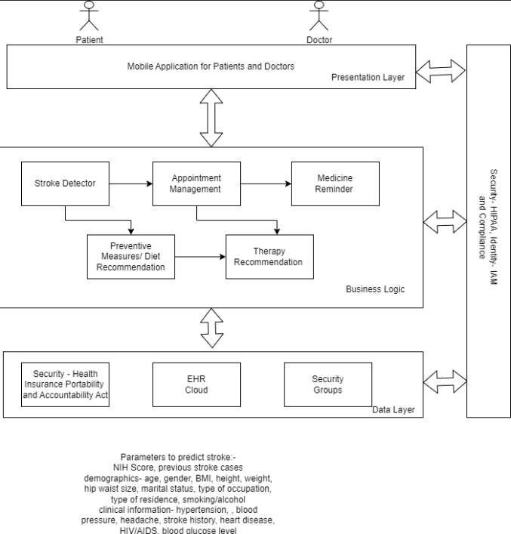
Conceptual Diagram
Parameters to predict stroke:
NIH Score, previous stroke cases
Demographics: age, gender, BMI, height, weight, hip waist size, marital status, type of occupation, type of residence, smoking/alcohol consumption
Clinical Information : Hypertension, blood pressure, headache, stroke history, heart disease, blood glucose level

Slide 18
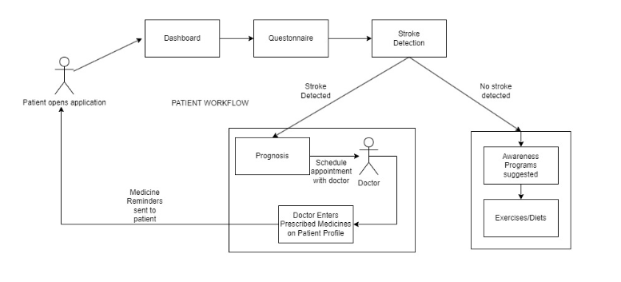
Patient Workflow

Slide 19
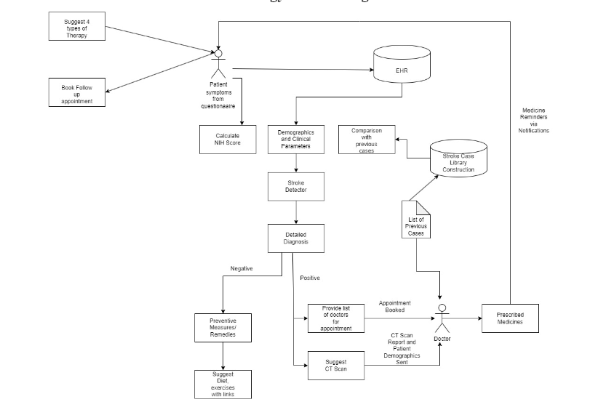
Block Diagram

Slide 20
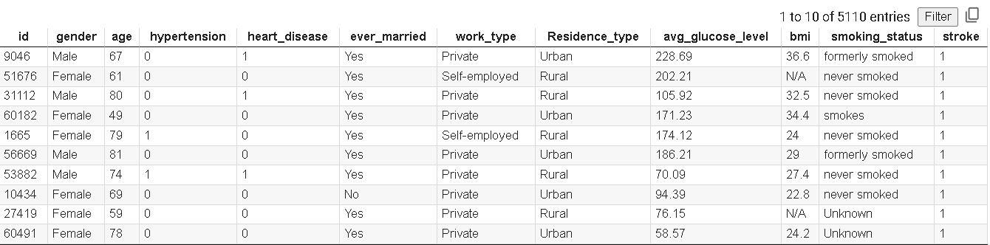
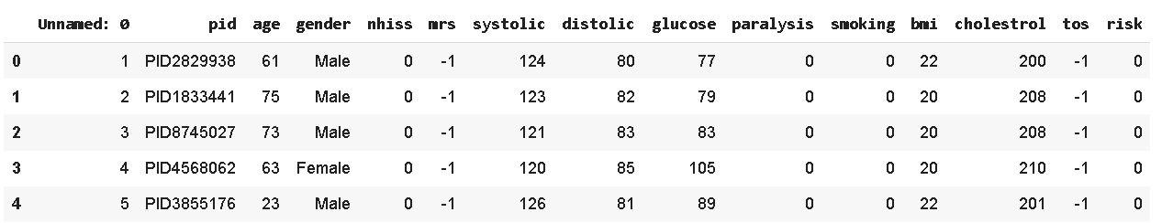
Machine Learning Model
https://colab.research.google.com/drive/1OoBvE3vgaxiEiJQhVCkcAKOi5cnYNzv8?usp=sharing
Dataset
Two stroke prediction datasets were merged to create a comprehensive dataset. One dataset, sourced from Kaggle, contained 5110 rows and 12 columns, while the second dataset, obtained from Mendeley, comprised 4798 rows and 15 columns. This merging was done to incorporate a wider range of demographic and health-related factors for more robust analysis.
Kaggle dataset
Mendeley Dataset

Slide 21
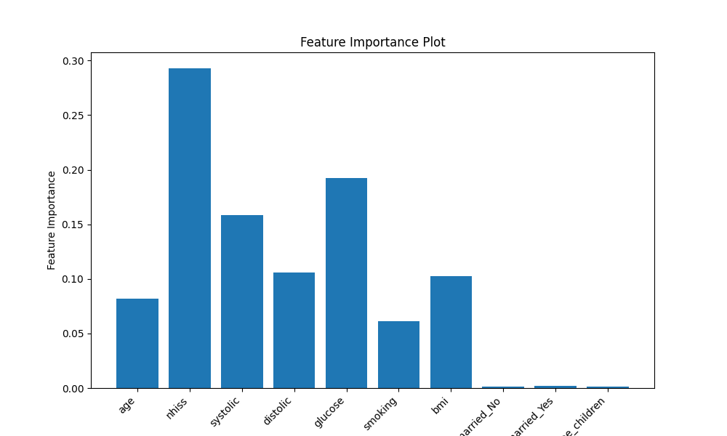
Machine Learning Algorithm
Feature Selection Technique:
Utilized ANOVA (Analysis of Variance) feature selection technique to identify the top 10 most significant features contributing to stroke risk prediction. This method helps in reducing dimensionality and focusing on the most relevant features.

Slide 22
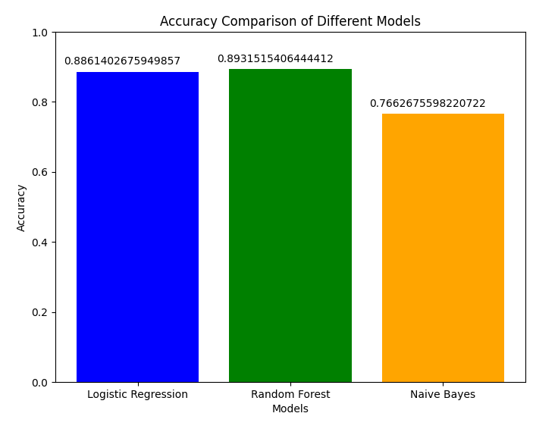
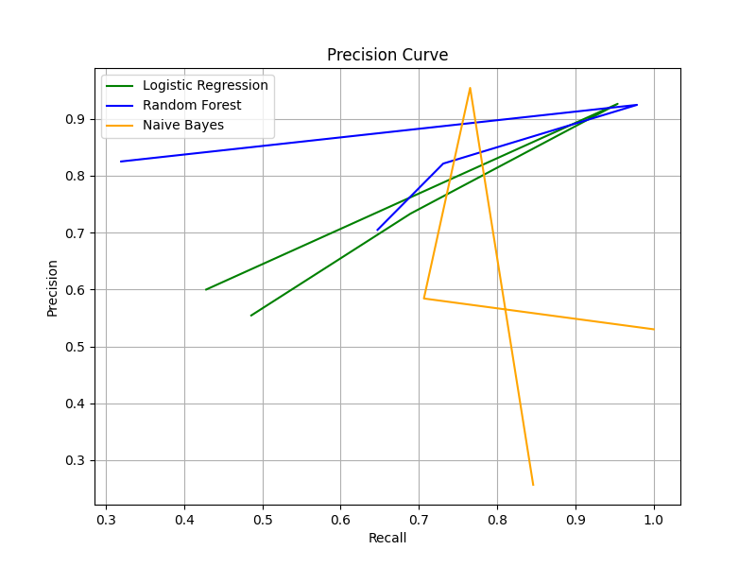
Machine Learning Algorithm
Algorithms
Logistic Regression
Random Forest
Naive Bayes

Slide 23
Workflow of the app - Patient side
Patient:-
Unique Patient ID generated on registration
Ask basic questions like height, weight, BMI, Marital status, and Smoking habits.
Patient answers Questionnaire
Answers are stored on the EHR cloud
The result of the diagnosis is displayed to the patient
Depending on the result, the patient is either recommended diet plans or preventive measures or given a list of doctors for appointments.
After the appointment is booked, it is sent to the respective doctor
The patient is sent reminders of his/her appointment
The patient can also book a follow-up appointment with the same doctor

Slide 24
Workflow of the app - Doctor Side
Doctor :
The doctor can log in using a unique Doctor ID
A list of upcoming appointments is displayed on the dashboard
The doctor can view the profile of any patient and after the appointment, enter the prescribed medicines so that the patient is sent timely reminders for the same

Slide 25
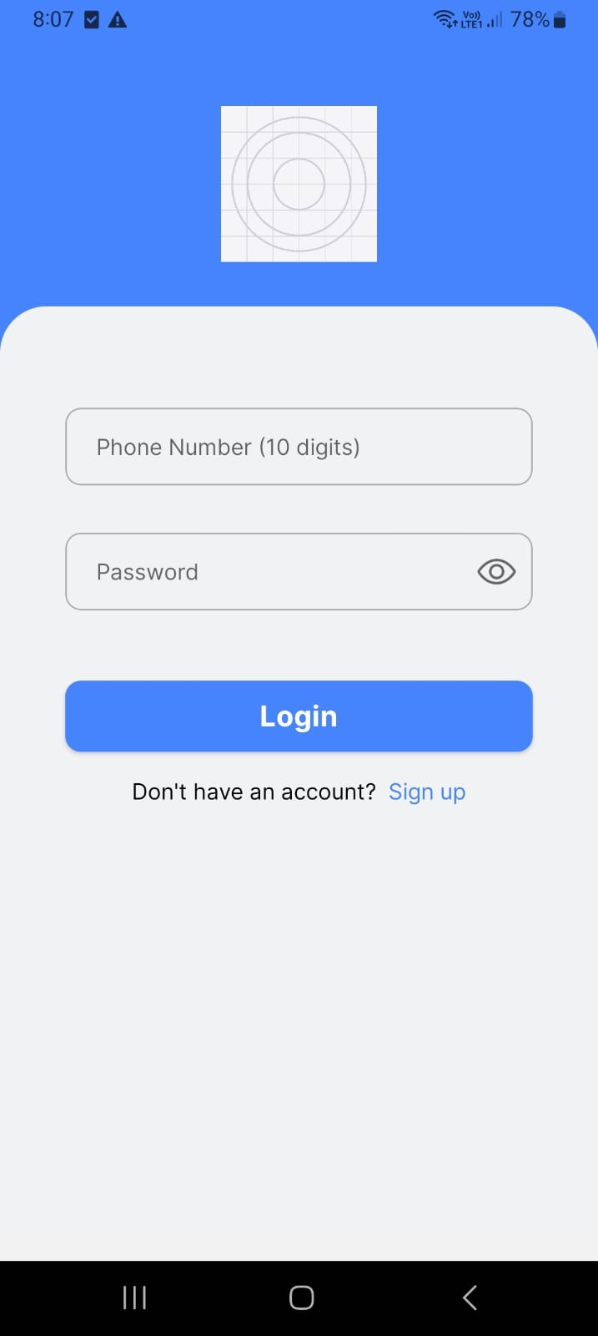
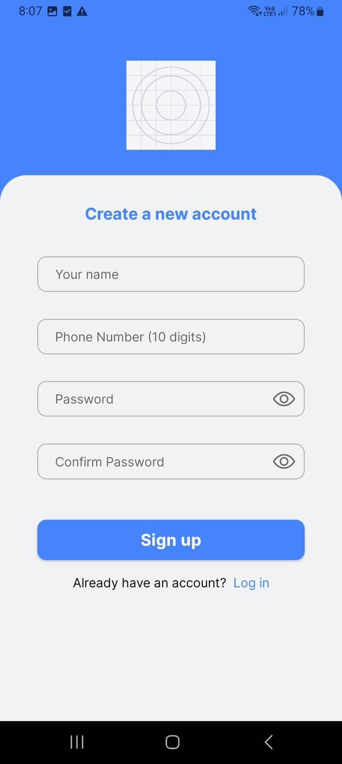
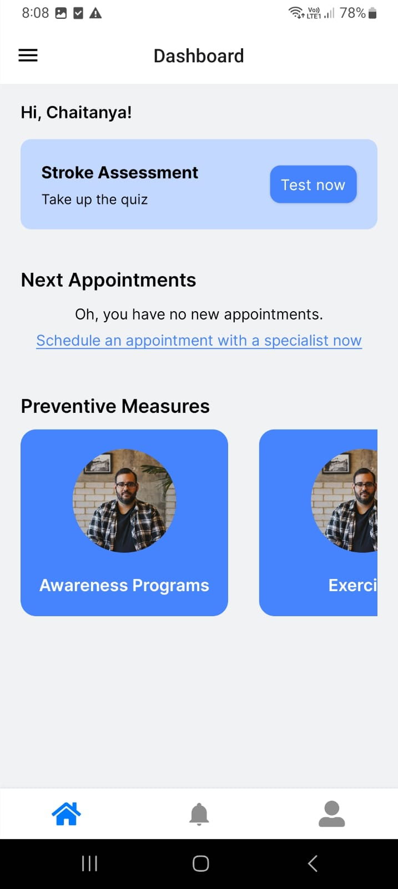
Implementation
Login Screen Register Screen Dashboard

Slide 26
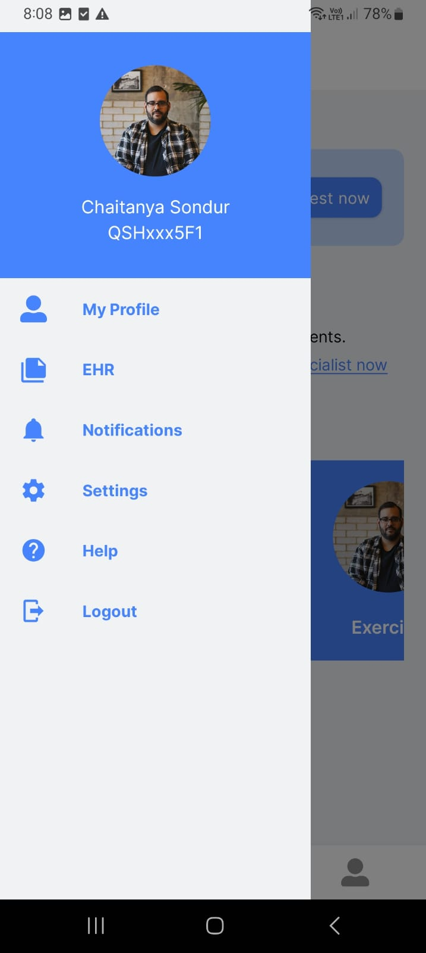
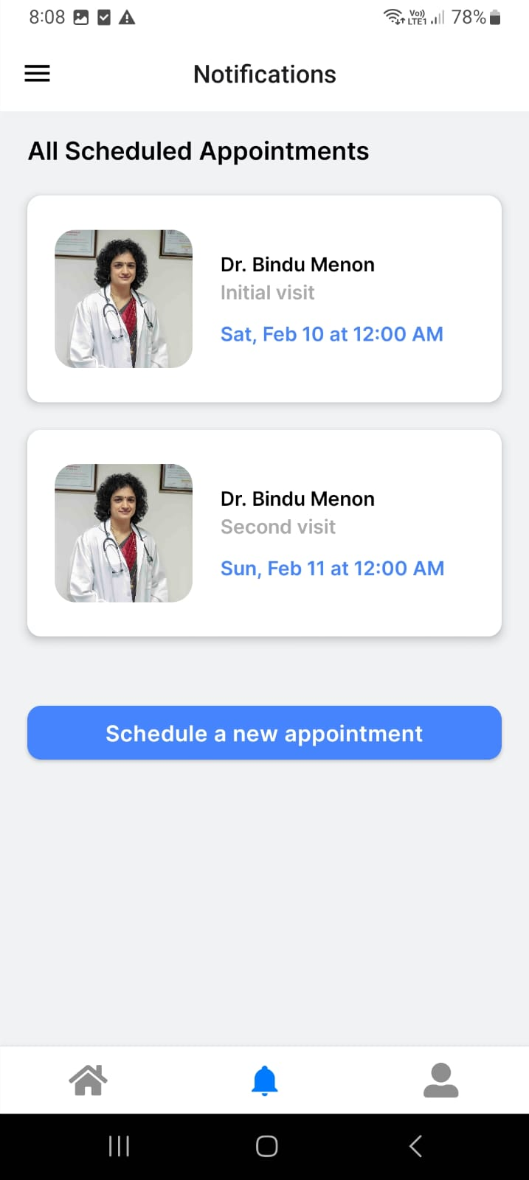
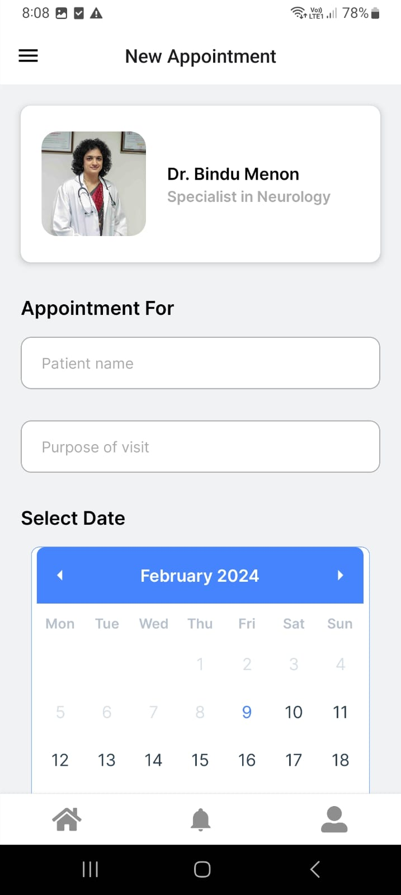
Implementation
Drawer All appointments Schedule appointments

Slide 27
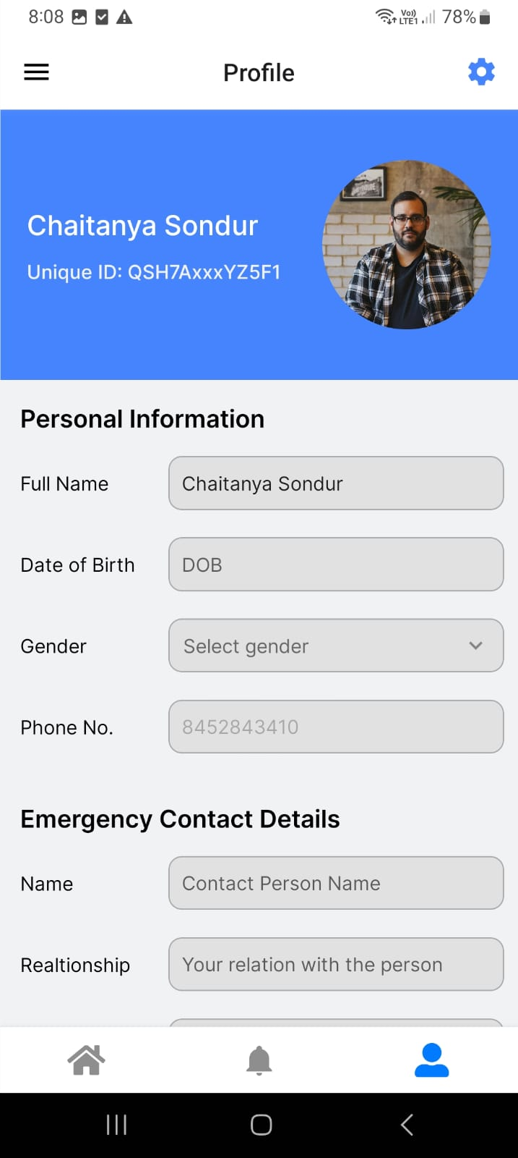
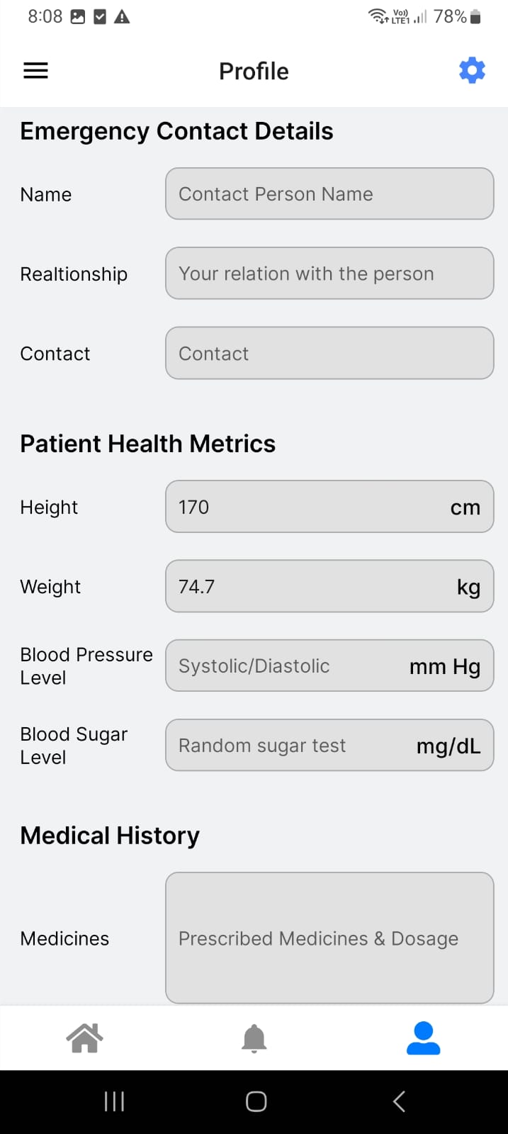
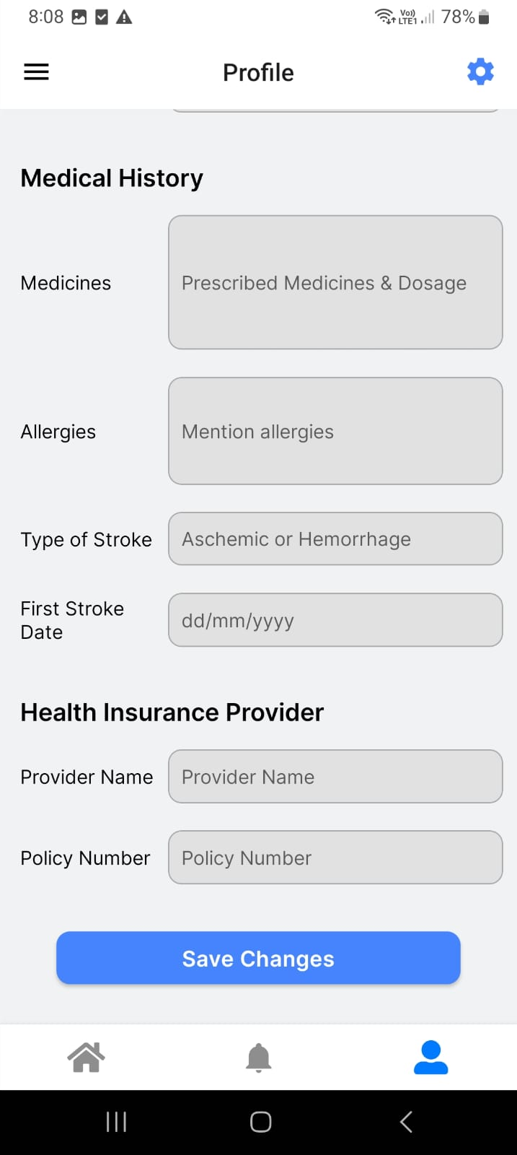
Implementation
Profile Page

Slide 28
Hardware and Software tools
Software:-
Github - for collaboratory work
React Native - for mobile app development
Firebase - for storing patient records
Figma - wireframing and designing
Hardware:-
Intel Core i3 Processor or higher
RAM >= 8GB
Laptop / Android / IoS based Smart Phones

Slide 29
Next Work Plan
Storing EHR of every patient in Firebase and implementing a blockchain based system
Blockchain technology can enhance security and integrity by providing immutable and decentralized data storage. Here's how you can integrate blockchain into your EHR system:
a. Choose a Blockchain Platform: Decide which blockchain platform suits your requirements. Ethereum, Hyperledger Fabric, and Corda are popular choices for enterprise-level applications. Each has its strengths and use cases.b. Data Structure: Define the structure of your blockchain to accommodate EHR data. Each block could contain a patient's medical records along with a timestamp. c. Smart Contracts: Use smart contracts to define rules and automate processes. For instance, you can create a smart contract to manage consent for accessing patient data or to execute predefined actions based on certain conditions.
d. Decentralization: Distribute the blockchain network across multiple nodes to ensure redundancy and fault tolerance. This prevents a single point of failure and enhances data resilience. e. Integration with Firebase: You can use Firebase as a backend service for handling user authentication, file storage, and other non-blockchain related functionalities. The blockchain can then be used specifically for storing and verifying the integrity of EHR data.f. Privacy and Compliance: Ensure compliance with healthcare regulations such as HIPAA (in the US) or GDPR (in the EU). Implement privacy features like encryption and data anonymization to protect patient confidentiality.

Slide 30
Conclusion
The application serves as a Clinical Decision Support System for patients and doctors where patients can take up risk assessment for stroke and the results will be sent to the expert, who will have the final say. Based on the result, the patient will be suggested to take action whether it is to follow a diet, perform certain exercises on a daily basis or consult the doctor. On consultation, medicines, exercises are suggested by the doctor until the follow-up. An Electronic Health Record system is maintained to store the data of patients such that it is readily available to the doctor.

Slide 31
References
[1] World Health Organization, “World Health Organization (WHO) Definition of Stroke,” Public Health, Aug. 17, 2020. https://www.publichealth.com.ng/world-health-organization-who-definition-of-stroke/
[2] R. Brown, “Stroke - Symptoms and Causes,” Mayo Clinic, Dec. 08, 2023. https://www.mayoclinic.org/diseases-conditions/stroke/symptoms-causes/syc-20350113
[3] National Institute of Neurological Disorders and Stroke, “Stroke,” www.ninds.nih.gov, Mar. 08, 2023. https://www.ninds.nih.gov/health-information/disorders/stroke
[4] L. Souza-Pereira, N. Pombo, S. Ouhbi, and V. Felizardo, “Clinical decision support systems for chronic diseases: A Systematic literature review,” Computer Methods and Programs in Biomedicine, vol. 195, p. 105565, Oct. 2020, doi: 10.1016/j.cmpb.2020.105565.
[5] S. Dev, H. Wang, C. S. Nwosu, N. Jain, B. Veeravalli, and D. John, “A predictive analytics approach for stroke prediction using machine learning and neural networks,” Healthcare Analytics, vol. 2, p. 100032, Nov. 2022, doi: 10.1016/j.health.2022.100032.
[6] T. Tazin, N. Alam, N. N. Dola, M. S. Bari, S. Bourouis, and M. M. Khan, “Stroke disease detection and prediction using robust learning approaches,” Journal of Healthcare Engineering, vol. 2021, pp. 1–12, Nov. 2021, doi: 10.1155/2021/7633381.
[7] C. S. Nwosu, S. Dev, P. Bhardwaj, B. Veeravalli, and D. John, “Predicting Stroke from Electronic Health Records,” Jul. 2019, doi: 10.1109/embc.2019.8857234.

Slide 32
References
[8] A. Bivard and M. Parsons, “Artificial intelligence for decision support in acute stroke current roles and potential,” Nature Reviews Neurology, vol. 16, no. 10, pp. 575–585, Aug. 2020, doi: 10.1038/s41582-0200-390-y.
[9] E. M. Alanazi, A. Abdou, and J. Luo, “Predicting risk of stroke from lab tests using machine learning algorithms: Development and evaluation of prediction models,” JMIR Formative Research, vol. 5, no. 12, p. e23440, Dec. 2021, doi: 10.2196/23440.
[10] S. F. Alasiri, A. Douiri, S. Altukistani, T. Porat, and O. Mousa, "The Role of Clinical Decision Support Systems in Preventing Stroke in Primary Care: A Systematic Review," *Perspect Health Inf Manag.*, vol. 20, no. 2, p. 1d, Apr. 2023.
[11] M. Chun et al., “Stroke risk prediction using machine learning: a prospective cohort study of 0.5 million Chinese adults,” Journal of the American Medical Informatics Association, vol. 28, no. 8, pp. 1719–1727, May 2021, doi: 10.1093/jamia/ocab068.
[12] M. Saxena, M. Choudhary, M. Deep, S. Bhamra, and M. Maru, “Issue 4 www.jetir.org (ISSN-2349-5162),” JETIR2204518 Journal of Emerging Technologies and Innovative Research, vol. 9, 2022.
[13] E. Akay, A. Hilbert, B. Carlisle, V. I. Madai, M. A. Mutke, and D. Frey, “Artificial Intelligence for Clinical Decision Support in Acute Ischemic Stroke: A Systematic Review,” vol. 54, no. 6, pp. 1505–1516, Jun. 2023, doi: https://doi.org/10.1161/strokeaha.122.041442.
‌[14] E. Dritsas and M. Trigka, “Stroke Risk Prediction with Machine Learning Techniques,” Sensors, vol. 22, no. 13, p. 4670, Jun. 2022, doi: https://doi.org/10.3390/s22134670.
‌

